Slide 1
Word Vectors/Word Embeddings

Slide 2
How to handle text in a deep model
Imagine you want to:
classify a document
Is it talking about politics, business, science?
Summarize a document
Carry out sentiment analysis
Do language translation
Search for information
Match customers to online advertisement
Create Chat bots/dialogue agents
…
What all this tasks have in common is that they need to work with human natural language

Slide 3
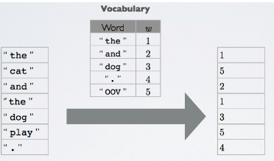
The issue with representing words for machine learning algorithms
Machine learning algorithms need numerical data (vectors) as input
Several methods have been used in the past to transform words into numerical representations with sub optimal results
Working with vectors of indexes does not work well with machine learning algorithms
associating each word with an index

Slide 4
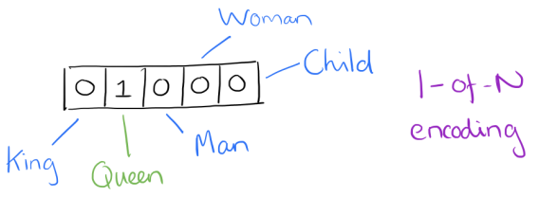
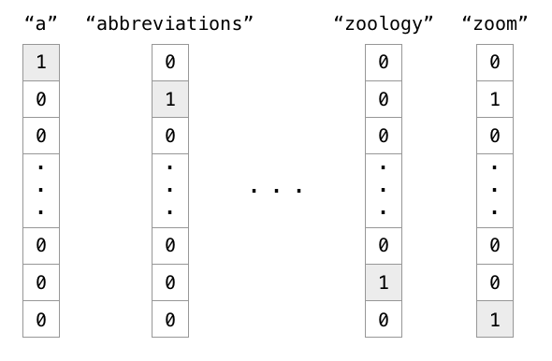
The issue with representing words for machine learning algorithms
An improvement over vectors of indexes is the one hot encoding of words
Suppose our vocabulary has only five words: King, Queen, Man, Woman, and Child. We could encode the word ‘Queen’ as:
Notice that the typical vocabulary size of a human language will be between 10,000 and 200,000 words
One hot encoded vectors are extremely sparse and wasteful
Using such an encoding, there’s no meaningful comparison we can make between word vectors other than equality testing (i.e. no way of conveying semantic or syntactic relatedness between words)

Slide 5
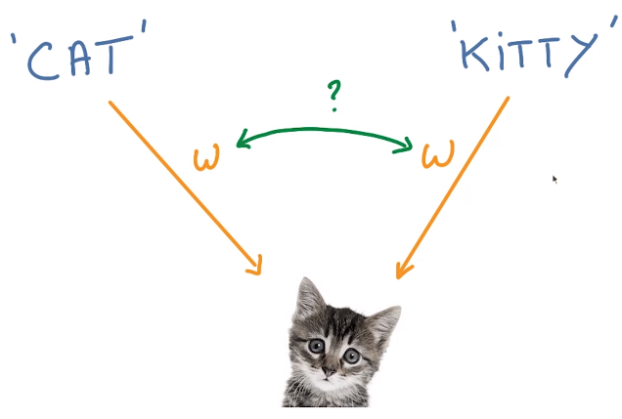
The issue with representing words for machine learning algorithms
Semantic ambiguity
We often use different words to mean almost the same thing
Like with image recognition, when we have things that are similar, it is very useful to share parameters
How do we represent words to a machine learning algorithm?
Discrete representations don’t work well
The previous 2 methods do not provide an efficient way of comparing word similarity

Slide 6
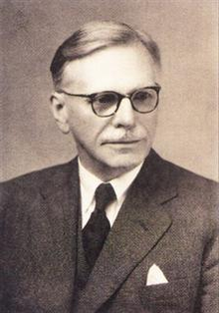
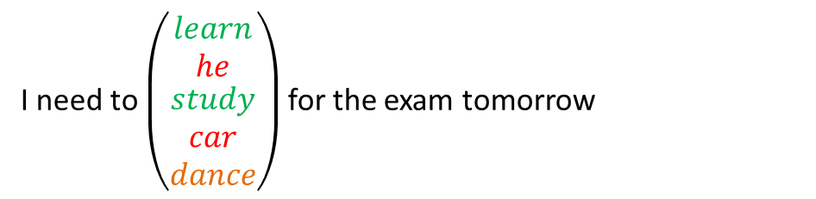
Distributional semantics
Research area that develops and studies theories and methods for quantifying and categorizing semantic similarities between linguistic items based on their distributional properties in large samples of language data
The distributional hypothesis in linguistics postulates that words that are used in the same contexts tend to purport similar meanings
The underlying idea was popularized by Firth in 1957
“a word can be characterized by the company it keeps"
John R. Firth
I need to $\left(\begin{matrix}learn \\ he \\ \begin{aligned}study \\ car \\ dance\end{aligned}\end{matrix}\right)$ for the exam tomorrow

Slide 7
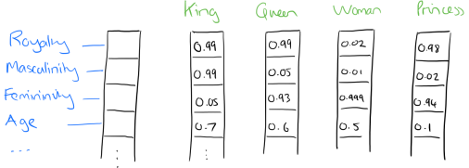
Word Embeddings/word vectors
Word embeddings and Word vectors are equivalent terms
Word embeddings are distributed representation of a word
Take a vector with several hundred dimensions (say 100)
Each word can be representated by a distribution of weights across those elements
So instead of a one-to-one mapping between an element in the one hot encoded vector and a word, the representation of a word is spread across all of the elements in the vector, and each element in the vector contributes to the definition of many words
Such a vector comes to represent in an abstract way the ‘meaning’ of a word.
Using neural networks trained on a large corpus, it’s possible to learn word vectors that are able to capture the relationships between words in a surprisingly expressive way.
We can then use the vectors as inputs to a neural network for natural language processing tasks

Slide 8
Word vectors have been instrumental to massively improve many NLP applications
Machine translation
Text classification
Sentiment analysis
Information retrieval (search engine searchers)
Question answering systems
Recommender systems
Many others

Slide 9
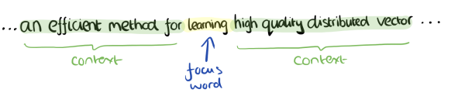
Word2Vec
Word2Vec is one way of learning those embeddings
Imagine a sliding window over the text, that includes the central word currently in focus, together with the four words that precede it, and the four words that follow it

Slide 10
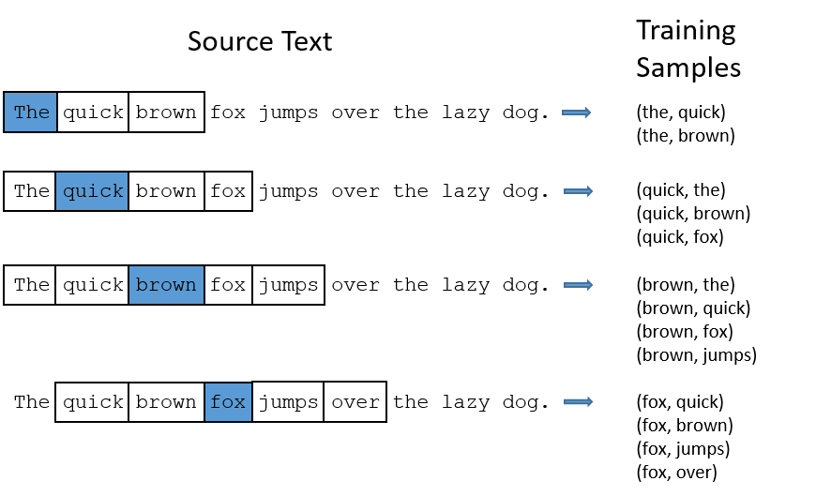
Word2vec training data
(target word, context word)
(target word, random word)
Positive
training samples
Negative
training samples
(the, red)
(the, an)
(quick, table)
(quick, school)
(quick, due)
(brown, psychology)
(brown, name)
(brown, published)
(brown, microphone)
(fox, institutional)
(fox, statement)
(fox, project)
(fox, research)

Slide 11
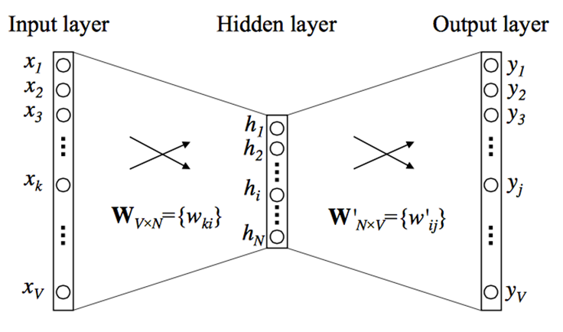
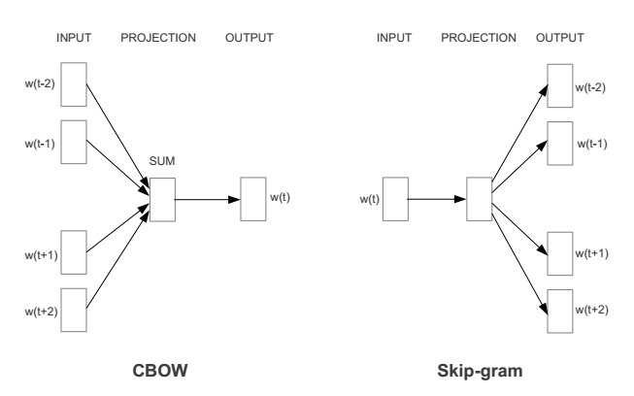
Learning word vectors
Word2vec offers two different neural network architectures to learn word embeddings: a Continuous Bag-of-Words model (CBOW) , and a Continuous Skip-gram model.

Slide 12
Intuition of word2vec
If two different words have very similar “contexts” (that is, what words are likely to appear around them), then our model needs to output very similar results for these two words. And one way for the network to output similar context predictions for these two words is if the word vectors are similar. So, if two words have similar contexts, then the word2vec network is motivated to learn similar word vectors for these two words!
And what does it mean for two words to have similar contexts? I think you could expect that synonyms like “intelligent” and “smart” would have very similar contexts. Or that words that are related, like “engine” and “transmission”, would probably have similar contexts as well.
Notice that the Word2vec algorithm has never been taught a single rule of English syntax. It knows nothing about the world, and is unassociated with any rules-based symbolic logic or knowledge graph.
And yet it learns more, in a flexible and automated fashion, than most knowledge graphs will learn after years of human labor refinement.

Slide 13
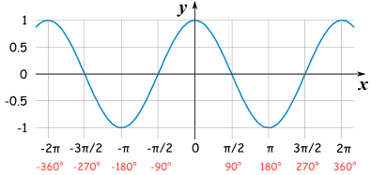
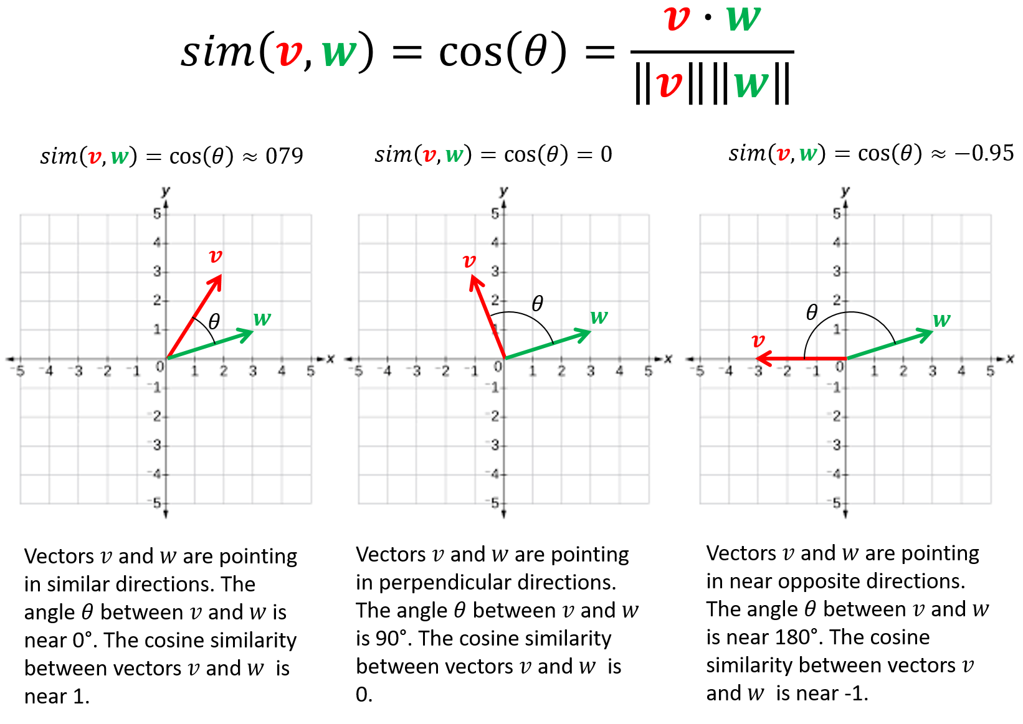

Estimating word similarity: cosine similarity (i.e. dot product)
$$y=cos⁡(x)$$

Slide 14
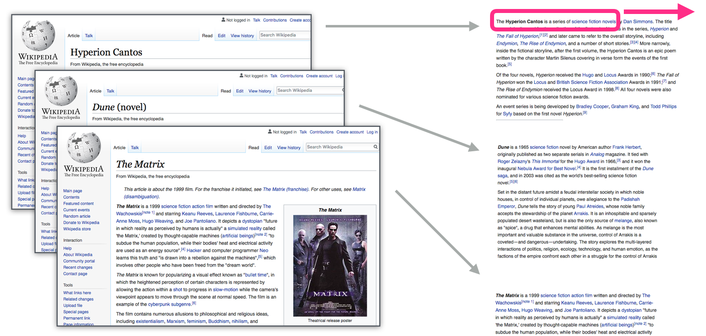
Training word2vec
Get a huge corpus of natural language text

Slide 15
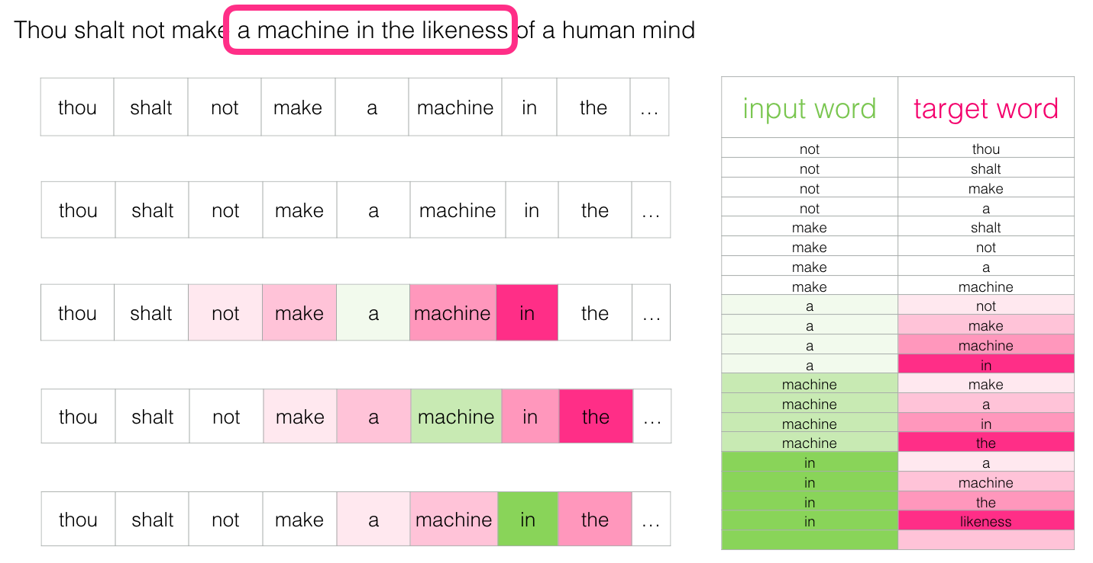
Training word2vec
Transform the text corpus into a structure format X with a target column y
Output word

Slide 16
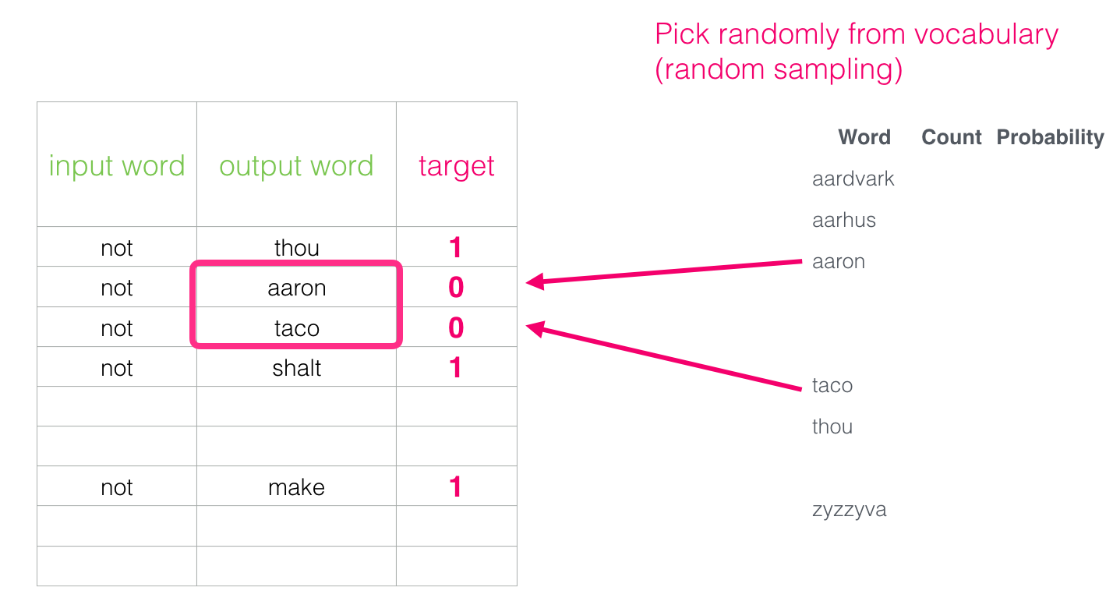
Training word2vec
Create a target column (y) to label the data
The target label 1 only refers to rows where the input word and output word are adjacent (share contexts) in the corpus
The target label 0 refers to pairs of input words and random words taken from the corpus

Slide 17
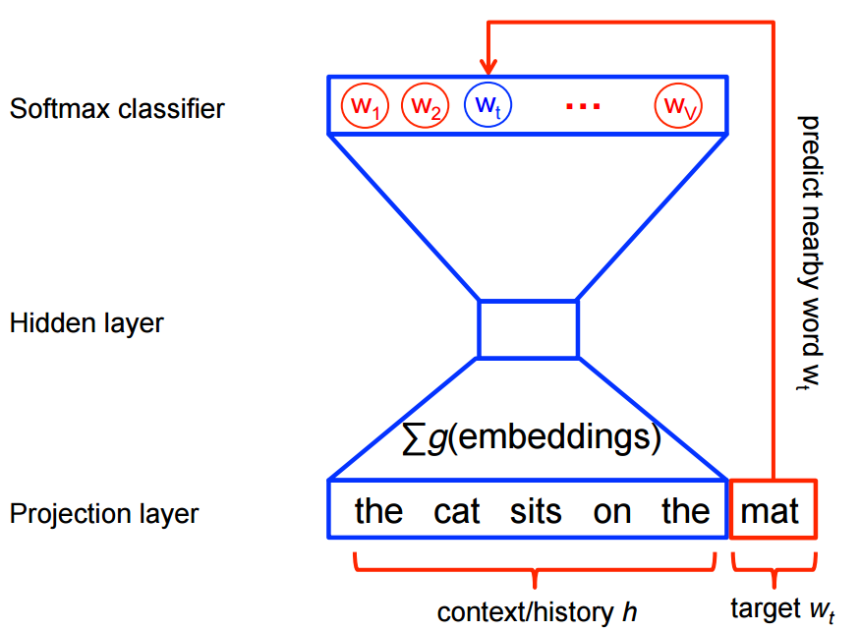
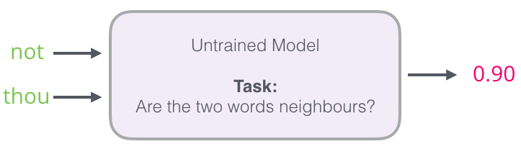
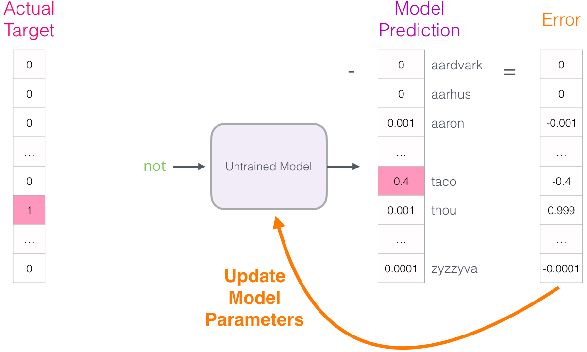
Training word2vec
Use a neural network whose task is to predict the output word from the input word (i.e. predict the context of the input word)

Slide 18
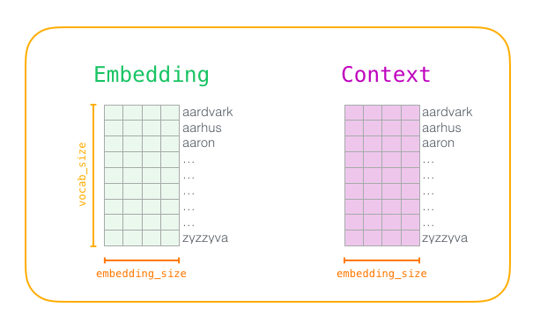
Training word2vec
At the start of the training process, we initialize these matrices with random values. Then we start the training process. In each training step, we take one positive example and its associated negative examples.

Slide 19
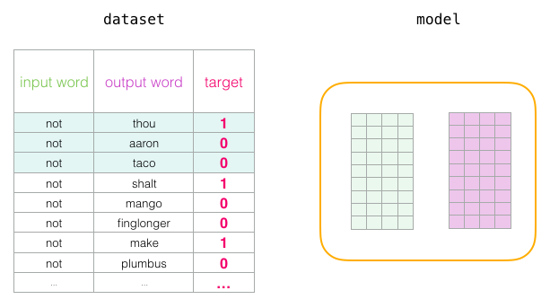
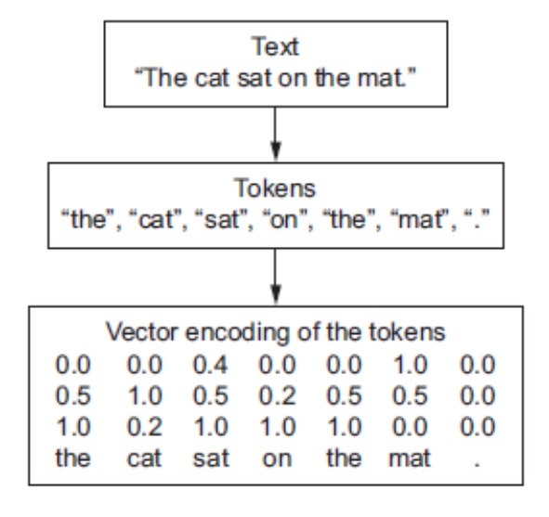
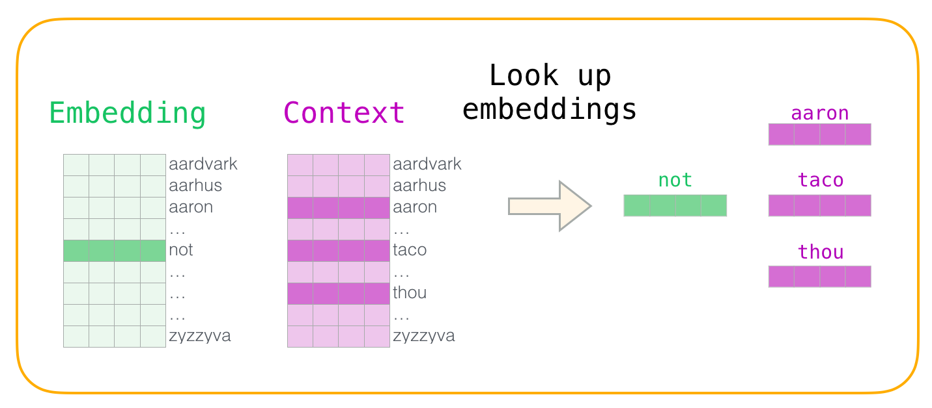
Training word2vec

Slide 20
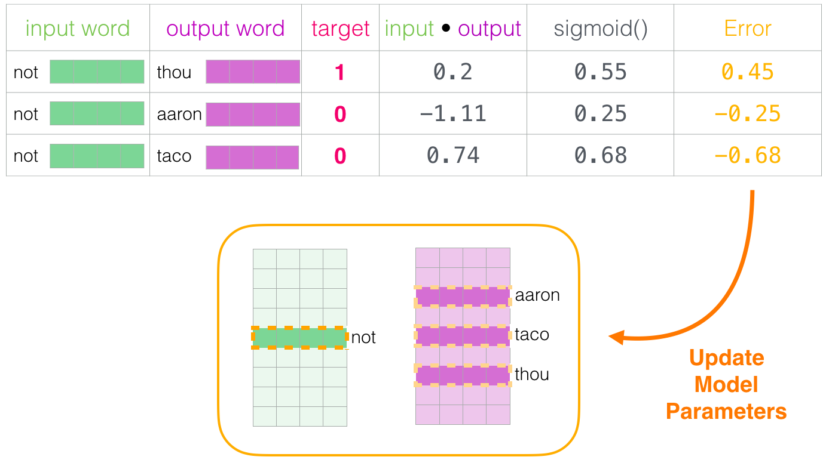
Training word2vec
We can now use the error score to adjust the embeddings of not, thou, aaron, and taco so that the next time we make this calculation, the result would be closer to the target scores.

Slide 21
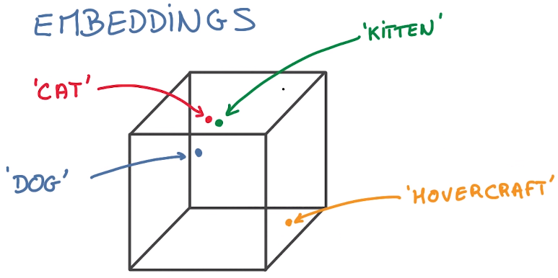
Vector space where the word embeddings live after training
Remember that a word Embeddings is just a mapping of words to distributed representations in the form of vectors
Vector embeddings will be close to each other in vector space when the words they represent have similar meanings
This is extremely useful for generalization: the holy Grail of artificial intelligence
A model no longer has to learn new things for every way there is to talk about a cat, it can generalize from this particular pattern of cat-like things

Slide 22
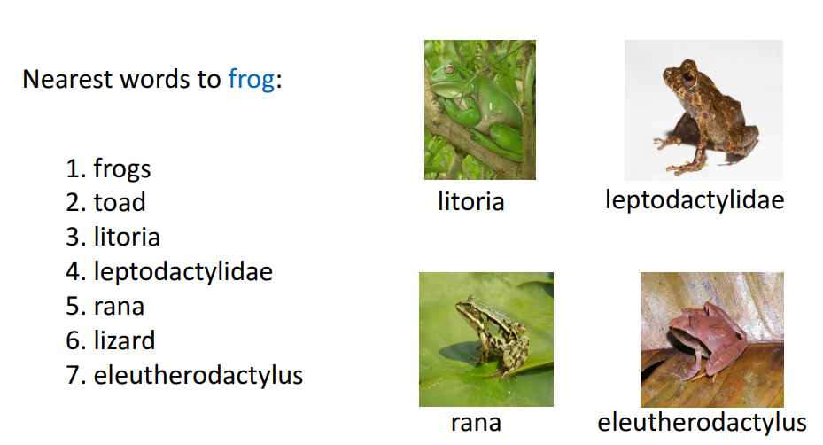
Word similarities

Slide 23
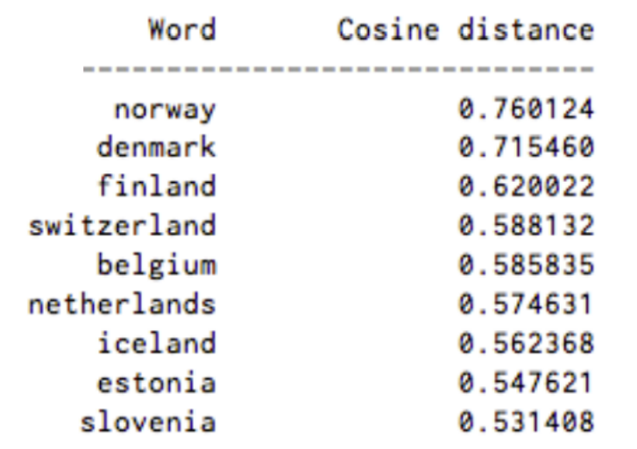
Closest words to “Sweden”

Slide 24
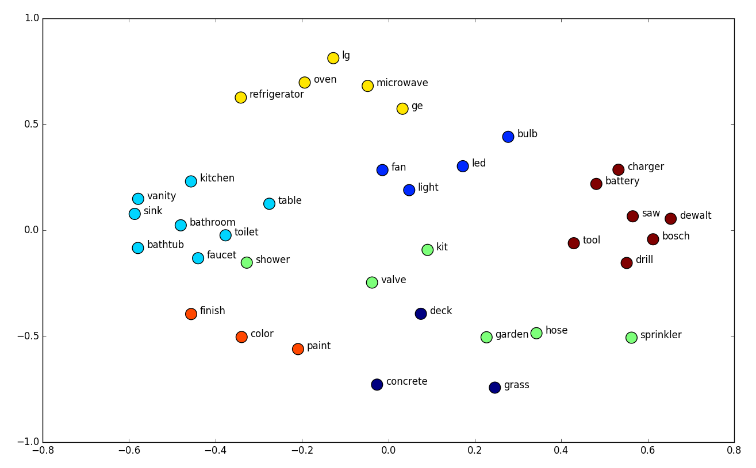
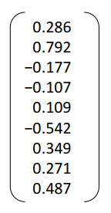

tSNE
Word embeddings usually consist of 100 to 1000 dimensions
We cannot visualize those vector spaces
We need to use dimensionality reduction techniques to project a high dimensional vector space of the word embeddings into 2 or 3 dimensions so we can visualize it
We could use PCA, but there is an even better technique
t-Distributed Stochastic Neighbor Embedding (t-SNE)
tSNE allows you to project a high dimensional word vector space into just 2 dimensions
High dimensional space projected into two-dimensional space
$$oven=$$

Slide 25
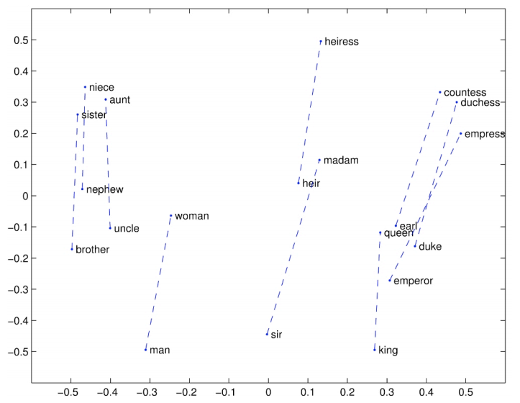
The word vector space also contains interesting linear semantic structures

Slide 26
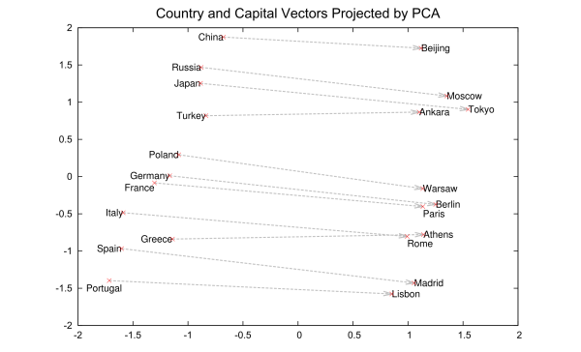
Linear semantic structure of the word vector space
Notes:
These vectors are the basis of a more comprehensive geometry of words. Not only will Rome, Paris, Berlin and Beijing cluster near each other, but they will each have similar distances in vectorspace to the countries whose capitals they are; i.e. Rome - Italy = Beijing - China. And if you only knew that Rome was the capital of Italy, and were wondering about the capital of China, then the equation Rome -Italy + China would return Beijing. No kidding.

Slide 27
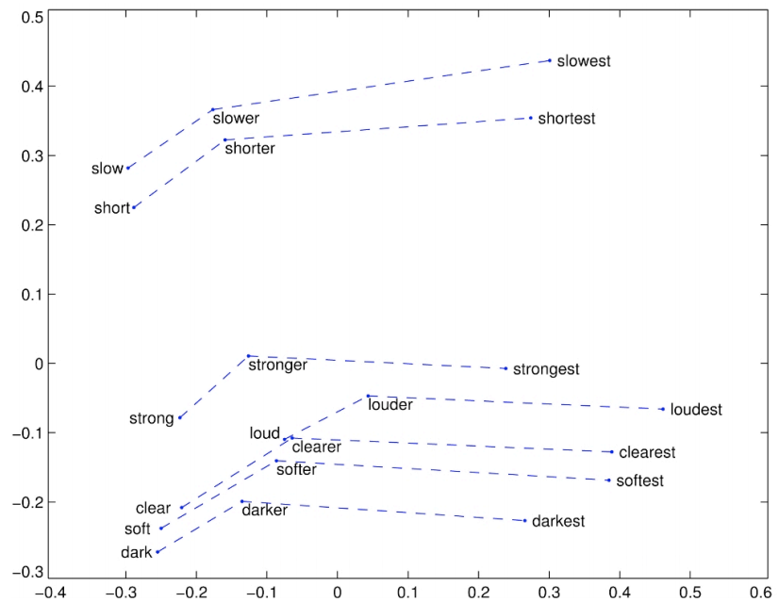
Syntactic structure of the word vector space

Slide 28
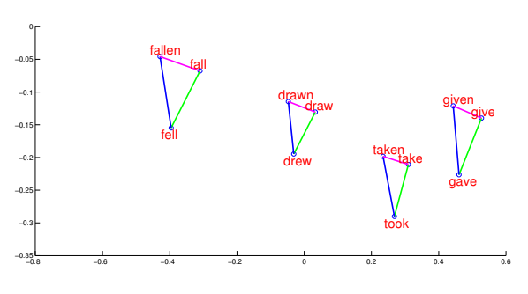
Syntactic Regularities in vector space

Slide 29
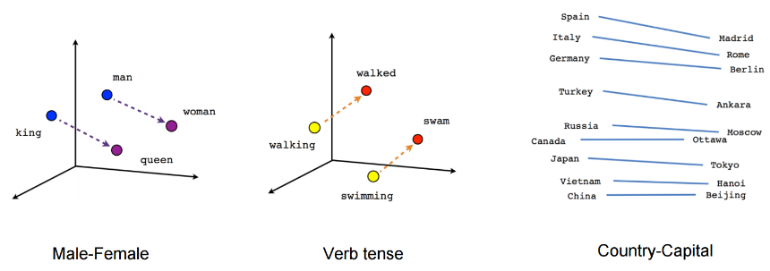
When we inspect these visualizations it becomes apparent that the vectors capture some general, and in fact quite useful, semantic and syntactic information about words and their relationships to one another.

Slide 30
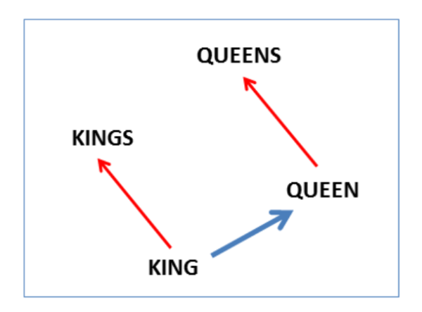
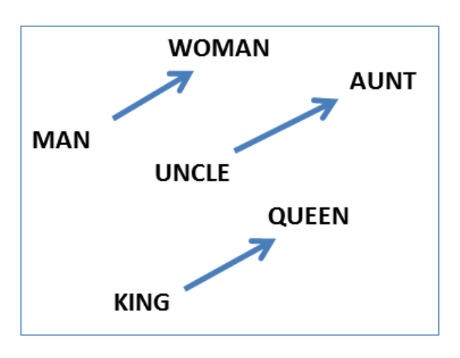
Reasoning with word vectors
Specifically, the regularities are observed as constant vector offsets between pairs of words sharing a particular relationship. For example, if we focus on the singular/plural relation, we observe
v_{kings} – v_{king} ≈ v_{queens} – v_{queen}
Perhaps more surprisingly, we find that this is also the case for a variety of semantic relations
v_{woman} – v_{man} ≈ v_{aunt} – v_{uncle} ≈ v_{queen} – v_{king}
Syntactic regularity
Semantic regularity

Slide 31
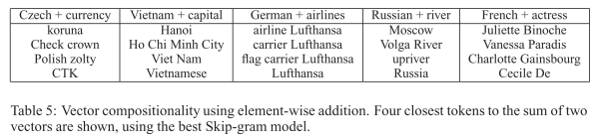
Vector addition
We can also use element-wise addition of vector elements to ask questions such as ‘German + airlines’ and by looking at the closest tokens to the composite vector come up with impressive answers
Huge implications for information retrieval

Slide 32
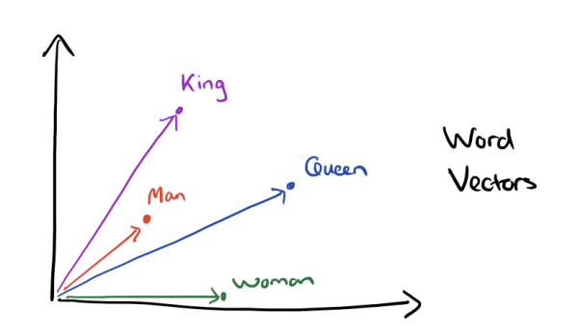
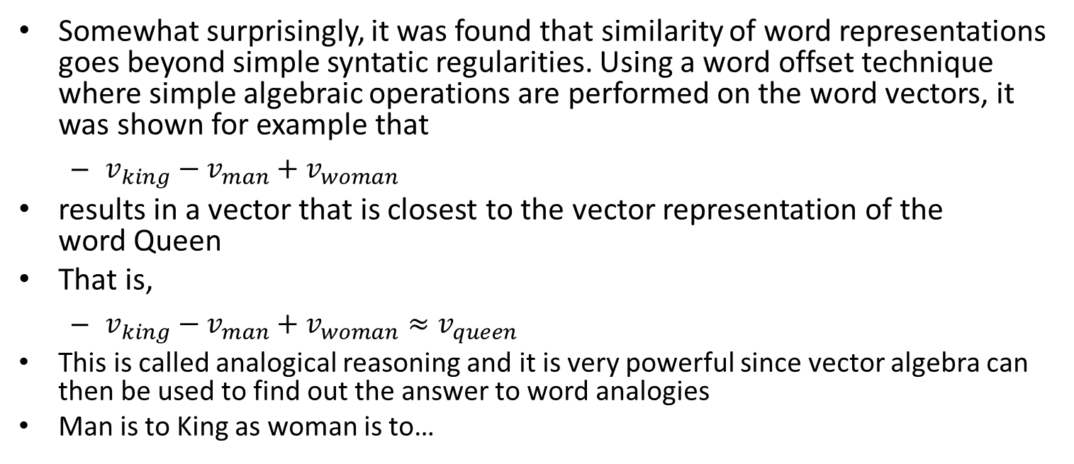

Somewhat surprisingly, it was found that similarity of word representations goes beyond simple syntatic regularities. Using a word offset technique where simple algebraic operations are performed on the word vectors, it was shown for example that
$v_{king}−v_{man}+v_{woman}$
results in a vector that is closest to the vector representation of the word Queen
That is,
$v_{king}−v_{man}+v_{woman}≈v_{queen}$
This is called analogical reasoning and it is very powerful since vector algebra can then be used to find out the answer to word analogies
Man is to King as woman is to…
$$v_{king}−v_{man}$$

Slide 33
Animation of the concept

Slide 34
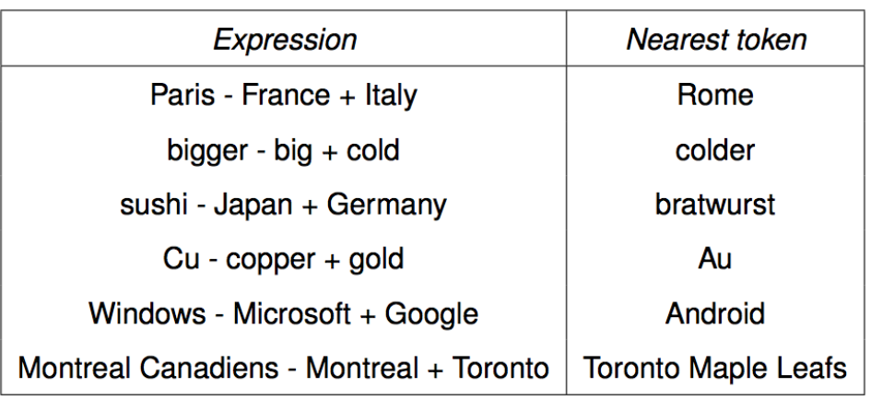
Word analogies
Paris is to France what Italy is to…

Slide 35
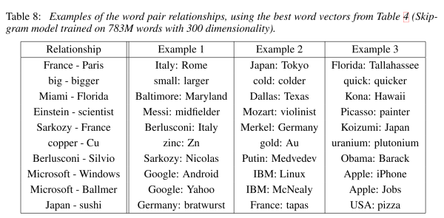
Here are some more results achieved using the same technique:

Slide 36








































































verb
royalty
gender
human
plural
feline
living being
$$cat→$$
$$0.6$$
$$0.9$$
$$0.1$$
$$0.4$$
$$−0.7$$
$$−0.3$$
$$−0.2$$
Dimensionality reduction of word embeddings from 7D to 2D
$$dog$$
$$cat$$
$$kitten→$$
$$0.5$$
$$0.8$$
$$−0.1$$
$$0.2$$
$$−0.6$$
$$−0.5$$
$$−0.1$$
$$kitten$$
$$dog→$$
$$0.7$$
$$−0.1$$
$$0.4$$
$$0.3$$
$$−0.4$$
$$−0.1$$
$$−0.3$$
$$houses$$
$$houses→$$
$$−0.8$$
$$−0.4$$
$$−0.5$$
$0.$1
$$−0.9$$
$$0.3$$
$$0.8$$
$$0.6$$
$$−0.2$$
$$0.8$$
$$0.9$$
$$−0.1$$
$$−0.9$$
$$−0.7$$
$$woman$$
$$man→$$
Dimensionality reduction of word embeddings from 7D to 2D
$$woman→$$
$$0.7$$
$$0.3$$
$$0.9$$
$$−0.7$$
$$0.1$$
$$−0.5$$
$$−0.4$$
$$man$$
$$queen$$
$$king→$$
$$0.5$$
$$−0.4$$
$$0.7$$
$$0.8$$
$$0.9$$
$$−0.7$$
$$−0.6$$
$$queen→$$
$$0.8$$
$$−0.1$$
$$0.8$$
$$−0.9$$
$$0.8$$
$$−0.5$$
$$−0.9$$
$$king$$
Word
Word embedding
Dimensionality reduction
Visualization of word embeddings in 2D

